Slide 1
Subsets of Psychology Name Institution Date

Slide 2
Introduction to the subsets of psychology
Psychology is the study of behavior and the mind
Psychology is divided into different subsets
The divisions are done according to the mental problem at hand
Notes:
Psychology is the study of behavior and the mind. It is divided into different sub-sets since it is a broad field. The branches are set apart according to the psychological problem at hand. They play a big role in guiding psychologists to easily identify where a victim’s ill behavior or mental disorder can be categorized (Buss, 2015). This way, a person is given the right mental or behavior solution from the onset, avoiding any possible confusion that can lead to wrong counseling. Some of the sub-sets are Developmental, Personality, Learning/Memory and Psychopathology, Biopsychology, and Perception Psychology. They are part of the many psychology branches and work hand in hand, complementing one another to solve mental disorders, which is usually complex.

Slide 3
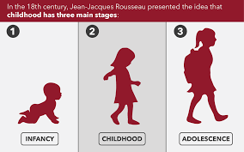
My Current Interests in the Already Covered Subsets
My key interests in the covered psychology subsets include:
To use developmental psychology to determine the relationship between the environment and human behavior
Passionate to assess how genetics influence a person’s reasoning
Under learning psychology am interested on how teachers can work with psychologist to design learning mechanisms
Notes:
The desire to help people and the zeal to know how human behavior and mind operate are primary forces that make people love psychology (Valsiner, 2016). My main interest in developmental psychology lies in the relationship between an individual’s character or behavior and environmental dynamics over time as he goes through different life stages. Also, I am interested in how genetics and upbringing influence a person’s feelings and mental reasoning shaping their unique personality. Additionally, learning psychology is a sub-set of psychology. I am interested in how teachers and school administrators can work hand in conjunction with psychologists to design learning mechanisms that help slow learners in class, for example, by developing an accommodative curriculum.

Slide 4
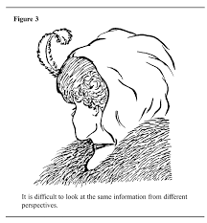
Continuation…
In Biopsychology, am passionate to know how the central the central nervous system operates to influence behaviors
Under perception psychology, am eager to understand how genetics and brain damages causes potential pitfalls to perception
Notes:
Moreover, under Biopsychology, I am passionate to know how the central nervous system operates to control body behaviors with deep concern on consciousness. The perception psychology is another important branch of psychology. I am eager to understand how genetics and brain damage causes potential setbacks to perception, making victims perceive things differently.

Slide 5
How can one utilize a degree in each of these fields of psychology?
Some of the ways in which one can make use a degree of the covered subsets of psychology:
A degree in developmental psychology is important in becoming a peer counselor especially in school or hospital setting.
Personality psychology degree is useful in hospital and corporate world in conducting pre job and personality tests
Learning psychology is essential in teaching in educational centers
Notes:
A degree in developmental psychology is essential in becoming a peer counselor, especially in school. It equips the holder with adequate knowledge and skills to understand a person's behavior from one stage of life to another and offer an explicit explanation of the cause of the changes (Huffman, 2017). Consequently, a bachelor's in personality psychology is useful in the hospital and corporate world. For example, in conducting some pre-job personality tests and training staff on interpersonal skills and conflict resolution skills. A bachelor's in learning psychology is very important, especially in educational centers. a teacher with this certificate has a very sharp edge in the job market. They can understand a student’s mental and behavior condition and offer solutions to fit their needs. Educational psychologists help schools assess the behavioral difficulties affecting learners and then propose the best instructional methods and materials that match certain groups of learners.

Slide 6
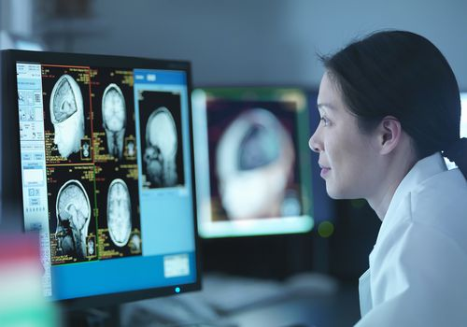
Continuation…
Degree in biopsychology can be used to work in educational centers, conducting lab and field researches for both humans and animals
A degree in perception psychology is imperative in varied hospital departments such as the mental health department, laboratory, clinical counselling and rehabilitation
Notes:
Biopsychology graduates are well equipped to work in educational centers, conducting lab and field researches for both humans and animals. They apply their biobehavioral knowledge to determine the scientific relationship between the brain and behavior. A degree in perception psychology is significant in hospitals in the mental health department, laboratory, clinical counseling, and rehabilitation. Patients are studied on how they perceive themselves according to the environment around them.

Slide 7
What should your undergraduate degree plan be for the field that interests you the most?
I have varied degree based plans and expectations in the field of developmental psychology. As such, I plan to:
Pursue Developmental Psychology as my major
Understand how a person’s behavior changes from one life stage or condition to another
My primary expectations is that:
Graduation requirement topics should include the child and behavior therapy, and development research theories
A proposal and research project should culminate the course
An attachment should be part of the course for grading
Notes:
I plan to major in developmental Psychology since I have a great zeal to understand how a person's behavior changes from one life stage or condition to another. Before graduating, some of the required topics of study include child and behavior therapy, development research theories and approaches, problem-solving skills, cognitive systems, aging psychology, and developmental psychology research (Buss, 2015). The research will be conducted while attached in a hospital or an organization as a role to be able to collect data for the study and also gain professional experience.

Slide 8
Will you need to go to Graduate School to pursue these careers?
The following are some of the reasons why I need to go to Graduate School to pursue these careers:
To meet my dream goal; that is, to become a proficient scholar in developmental psychology
To get a more holistic understanding on human mental growth and development
To get a post graduate certificate that will facilitate me to get a developmental psychologist license and secure a greener job
Notes:
Since my goal is to become a scholar proficient developmental psychologist, is a plan to advance my knowledge and skill by pursuing a master's in developmental psychology. With these graduate studies, I will get a more holistic understanding of human growth and development over the lifetime in terms of physical, cognitive, social, intellectual, perceptual, personality, and emotional growth aspects. This certificate will also facilitate me to get the developmental psychologist license that enables me to offer teaching services and conduct further research. My services will be premium based on graduate school exposure and knowledge.

Slide 9
What surprised you the most about each of these fields?
Each of the subsets of psychology are quite fascinating. I was surprised to learn how:
Developmental psychology illustrates on the relationship between nature and nurture
Personality psychology helps to understand our traits as well as those of other people
Psychopathology psychology is crucial in understanding the mental disorders and maladaptive behaviors.
Biopsychology psychology helps researchers to attain a greater understanding of how brain and nervous system challenge human behavior
Perception psychology boosts ones experience on the world around us.
Notes:
The varied subsets of psychology are quite fascinating. I was surprised to learn how developmental psychology illustrates on the relationship between nature and nurture. Developmental psychology is mainly concerned with infants and children and how human beings unfold in their life. I was surmised on how personality psychology helps to understand our traits as well as those of other people. I found psychopathology psychology to be crucial in understanding the mental disorders and maladaptive behaviors. I found biopsychology psychology to be a great subset of psychology in that it helps researchers to attain a greater understanding of how brain and nervous system challenge human behavior. Ultimately, perception psychology boosts ones experience on the world around us.

Slide 10
Conclusion
This assignment has been an eye opener to my understanding the applicability to varied subsets of psychology. I learned how:
Psychology is used to help diverse group of people
Psychology helps in achievement of one’s full potential
Human behavior and mental patterns can be interpreted scientifically
Psychologists exist in a unique approaches that helps them to fit in all workplaces
Notes:
The most interesting part of this assignment entails how psychology is used to help diverse groups of people from infants to old age live more happily with relaxation while unleashing their full potential. I learned the way human behavior and mental patterns can be interpreted scientifically providing a solution to wide groups of people who face similar mental disorders. In addition, this assignment has bolstered my understanding that psychologists are unique in the way they fit in all workplaces with their critical role of helping management to select, train, and motivate workers.

Slide 11
Cont...
Mental health problems are ideal issues facing the majority of humans
Thorough understanding in psychology helps one in accurate decision making in all avenues of life
There is need for accurate research on psychological changes of individuals as they move from one life stage to another
Notes:
This assignment has been an eye opener to my psychological understanding. I have learned that every person is featured with some sort of mental problems as they move from one life stage to another that influences their behavior. Mental issues mostly a result of the life challenges that occur while switching from one environment to another. This makes psychology one of the most needed disciplines in society today, especially amidst the unpredictable and inhumane covid-19 pandemic. Further, research on psychological changes of individuals as they shift from one living environment to another will enable me to estimate the extent to which an individual behavior changes. This study will allow me to develop a hypothesis to assess how different environmental exposures can influence behavior.

Slide 12
References
Buss, D. (2015). Evolutionary psychology: The new science of the mind. Psychology Press.
Huffman, K., Dowdell, K., & Sanderson, C. A. (2017). Psychology in action. John Wiley & Sons.
Valsiner, J., Marsico, G., Chaudhary, N., Sato, T., & Dazzani, V. (2016). Psychology as the science of human being. The Yokohama Manifesto, 129-147.

